Slide 1

B.Tech. — BCSE497J Project-I
Deadline-Aware Video Summarisation with an SLA-Constrained, Cost-Aware Scheduler
Team members:
<< Name >> (<< Reg. No. >>)
<< Name >> (<< Reg. No. >>)
<< Name >> (<< Reg. No. >>)
Faculty guide:
<< Guide Name >>, << Designation >>
School of Computer Science and Engineering, VIT Vellore

Slide 2

Approval Mail From Guide
Approval for the aim, objectives, architecture, modules and outcome was sought from the project guide by e-mail before 21-10-2026.
All points raised by the guide have been addressed and updated by the project team.
<< Paste the approval e-mail screenshot below. >>

Slide 3
Aim
To build a video-understanding system that returns a usable explanation of a lecture or tutorial within a stated wall-clock deadline, by predicting how long each stage will take on each available machine and choosing the cheapest configuration that still meets that deadline.
The aim is therefore not only accuracy of the summary, but delivery of it inside a budget the user is told in advance.

Slide 4
Abstract
Existing summarisation pipelines run a fixed set of models and finish whenever they finish; on a long lecture that can be hours, with no estimate offered beforehand.
This project adds a scheduler that keeps, for every hardware class, an execution-cost model of the form fixed + rate × input-minutes, fitted online from completed jobs, and uses it to route each job to the cheapest class predicted to meet the deadline.
The pipeline itself has seven stages — ingest, transcribe, vision, fuse, understand, index and highlight — and the planner may lower model fidelity rather than miss the budget.
On 31 recorded runs the scheduler met its budget on 64.5% of jobs against 6.5% for a fixed, highest-fidelity configuration. A 11.4-minute lecture completes in 159 s, about 4.3× faster than real time.
The summariser scores F1 0.262 on TVSum against a human agreement of 0.260 and a random baseline of 0.166, under 5-fold cross-validation.

Slide 5


Literature Review
Each source below was read in full; the right-hand column is the limitation this project responds to.
Source | What it does | Limitation addressed here
US 2014/0229221 A1 | Estimates job duration from prior runs; picks the lowest-cost pool meeting a need-by time | Cloud batch compute; no model-fidelity choice, no explicit fixed-overhead term
Romero et al., INFaaS (USENIX ATC '21) | Selects model variant and hardware jointly under latency/accuracy SLOs | Per-query inference serving; cost does not scale with input length
Deneke et al.; FastTTPS | Predicts transcoding time by linear regression on video features | Prediction only — not used to pick between machines under a deadline
Otani et al., CVPR 2019 | Shows F1 on TVSum/SumMe is inflated; proposes rank-correlation protocol | Adopted here: τ and ρ are reported beside F1, with human baselines
Potapov et al., KTS | Kernel temporal segmentation into shots for summarisation | Segmentation only; no scheduling or delivery guarantee

Slide 6
Research Gap
Runtime prediction and deadline-aware scheduling exist separately; the media-summarisation literature does not combine them.
Transcoding-time work predicts duration but stops there — the estimate is not used to choose between machines of different cost.
Deadline-aware cloud schedulers choose a machine, but model duration as proportional to input size, with no fixed-overhead term, and never trade model accuracy to keep a deadline.
Summarisation benchmarks report F1 alone, which Otani et al. showed can exceed human agreement while ranking segments no better than chance.
Gap addressed: one system that predicts per-stage cost per hardware class, routes on it, degrades fidelity rather than overrun, and is evaluated against human agreement rather than F1 alone.

Slide 7


Objectives
Build the seven-stage pipeline end to end, from a URL or an upload to a chaptered explanation, transcript, quiz and practice set.
Maintain a per-hardware-class execution-cost model, fitted online from completed jobs at constant work per job.
Route each job to the cheapest class predicted to meet its deadline, and declare infeasibility before the job starts rather than after.
Evaluate the summariser against human agreement on TVSum and SumMe, not F1 alone.
Identified: Sustainable Development Goals | | Outcomes ((Patent / Conference (Scopus)
/ Journal (Scopus) / Start-up/ Product/ Others}

Slide 8
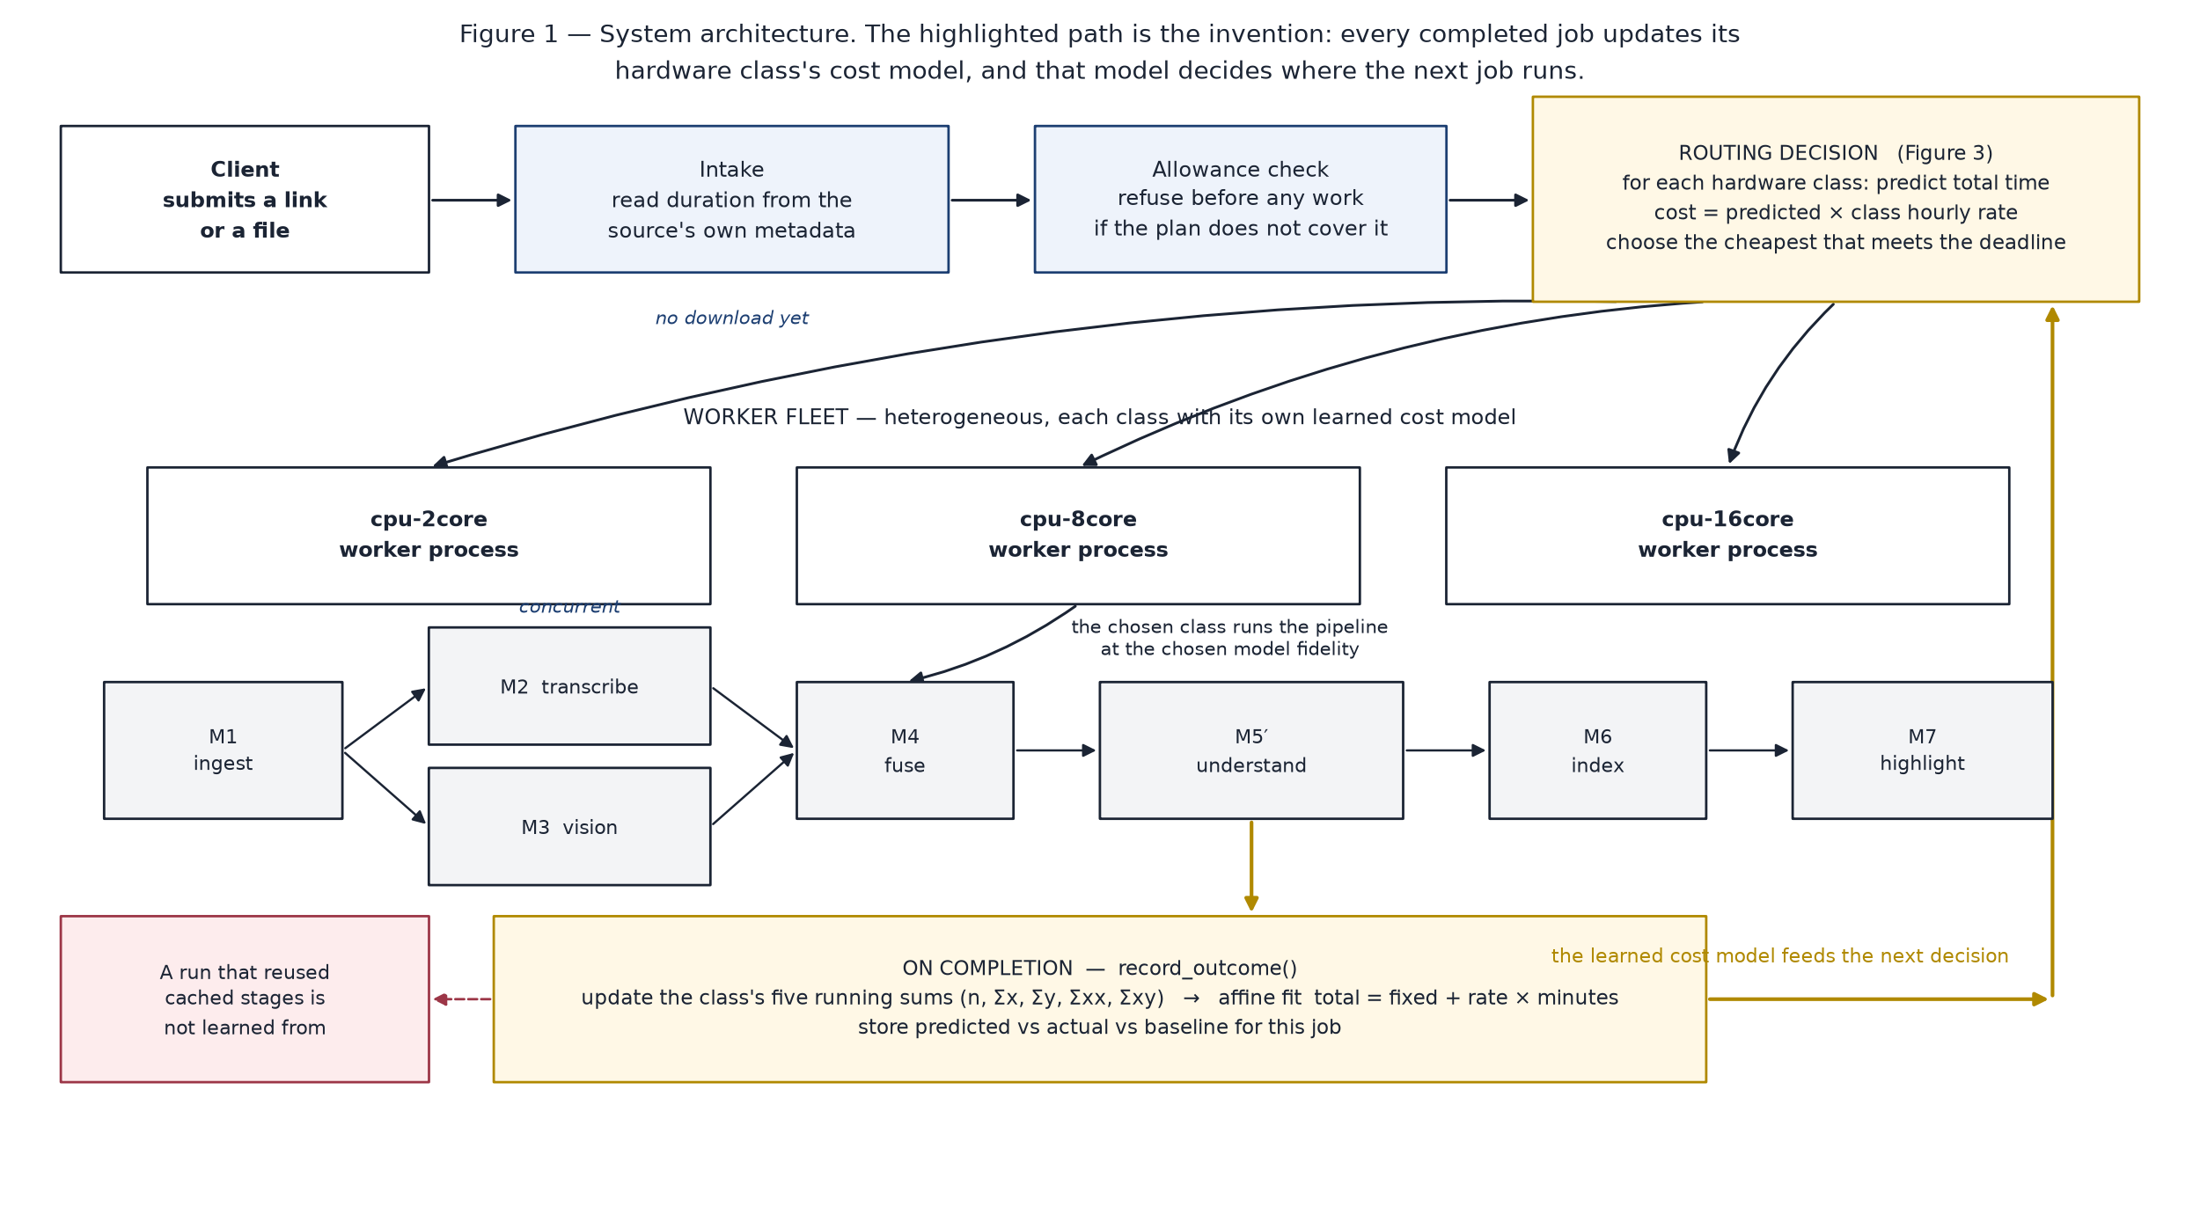
Framework/Architecture/Block Diagram
Seven stages: M1 ingest → M2 transcribe and M3 vision (concurrent) → M4 fuse → M5′ understand → M6 index → M7 highlight.

Slide 9
Functional Requirements
Accept a video as a link or an upload, and show a time estimate before processing starts.
Produce a chaptered explanation with timestamps, a scene grid, a transcript, a quiz, flashcards, a mind map and an audio overview.
Extract every problem solved in the video and restate it in any dialect of the same family — MySQL, PostgreSQL, Oracle, SQL Server, SQLite; Python, Java, C++, JavaScript, C#, Go.
Answer questions about the video with citations back to the moment.
Authenticate by e-mail OTP, phone OTP or Google, and enforce a per-tier allowance — four hours of video on the free tier, fifteen on premium.
Resume a part-completed run from cache instead of recomputing it.

Slide 10
Modules
M1 Ingest — fetch or accept upload, probe duration, extract audio.
M2 Transcribe — Whisper, language auto-detected, long audio chunked.
M3 Vision — scene detection, keyframes, object and on-screen text; runs concurrently with M2.
M4 Fuse — align every sentence to the scene it was spoken over.
M5′ Understand — a language model reads the fused document in windows and writes the explanation, quiz and practice set.
M6 Index — FAISS index over passages, for cited question answering.
M7 Highlight — a trained importance model scores shots and cuts a reel.
Scheduler — predicts each stage's cost per hardware class and routes the job; calibrates from every completed run.

Slide 11
Experiments and Results
Scheduling, over 31 recorded SLA observations:
  Scheduler met the budget on 64.5% of jobs; a fixed highest-fidelity configuration met it on 6.5%.
  Counterfactuals computed from the measured per-minute costs: always 16-core 71.0%, random choice 61.3%, always 2-core 51.6%. These assume the cost model is exact; the 64.5% is measured and includes real provider stalls.
Throughput: an 11.4-minute lecture completes in 159.2 s — about 4.3× faster than real time (ingest 16.7 s, analyse 69.8 s, summarise 43.5 s, index 2.9 s).
Summarisation quality, 5-fold cross-validation over 75 videos:
  TVSum — F1 0.262 vs human 0.260, random 0.166; Kendall τ 0.214.
  SumMe — F1 0.445 vs human 0.612, random 0.368; Kendall τ 0.053, so ranking on SumMe is close to chance and is reported as such.
Correctness: 190 automated tests pass.

Slide 12
Conclusion and Future Work
A deadline is treated as a first-class input: the system predicts, routes, and says before starting whether the budget is reachable.
The learned affine cost model is what makes that possible, and it improves with every completed job at constant cost per update.
Honest limits: the flat 300 s budget is unreachable for multi-hour videos, so most misses are structural; and the always-16-core counterfactual is not beaten on attainment — the scheduler's claim is comparable attainment at lower cost, which a direct A/B has not yet measured.
Future work: a measured A/B against a fixed 16-core assignment; a length-proportional budget; a second cost term for output bitrate; and GPU worker classes, which the routing already supports.

Slide 13
Outcome Achieved
Patent — invention disclosure prepared, not yet filed.
  Form IDF-B completed for the SLA-constrained scheduler, with three figures drawn from the running system.
  A design-registration disclosure completed for the interface, with eight representations captured from the application.
  A prior-art search was carried out before filing. It found that the broad claim appears anticipated by US 2014/0229221 A1, so a narrowed combination claim is being prepared with the VIT IPR Cell.
Product — the system is deployed and reachable, with authentication, per-tier allowances and payment integration working against live APIs.
Sustainable Development Goal 4, Quality Education: the system makes long-form lecture content searchable and answerable.

Slide 14
References
[1] Amazon Technologies, “Cost-aware scheduling of compute jobs against a need-by time,” US Patent Application US 2014/0229221 A1, Aug. 2014.
[2] F. Romero, Q. Li, N. J. Yadwadkar and C. Kozyrakis, “INFaaS: Automated model-less inference serving,” in Proc. USENIX ATC, 2021, pp. 397–411.
[3] T. Deneke, H. Haile, S. Lafond and J. Lilius, “Video transcoding time prediction for proactive load balancing,” in Proc. IEEE ICME, 2014.
[4] M. Otani, Y. Nakashima, E. Rahtu and J. Heikkilä, “Rethinking the evaluation of video summaries,” in Proc. IEEE/CVF CVPR, 2019, pp. 7596–7604.
[5] D. Potapov, M. Douze, Z. Harchaoui and C. Schmid, “Category-specific video summarization,” in Proc. ECCV, 2014, pp. 540–555.
[6] A. Radford et al., “Robust speech recognition via large-scale weak supervision,” in Proc. ICML, 2023, pp. 28492–28518.
[7] J. Johnson, M. Douze and H. Jégou, “Billion-scale similarity search with GPUs,” IEEE Trans. Big Data, vol. 7, no. 3, pp. 535–547, 2021.

